Slide 1
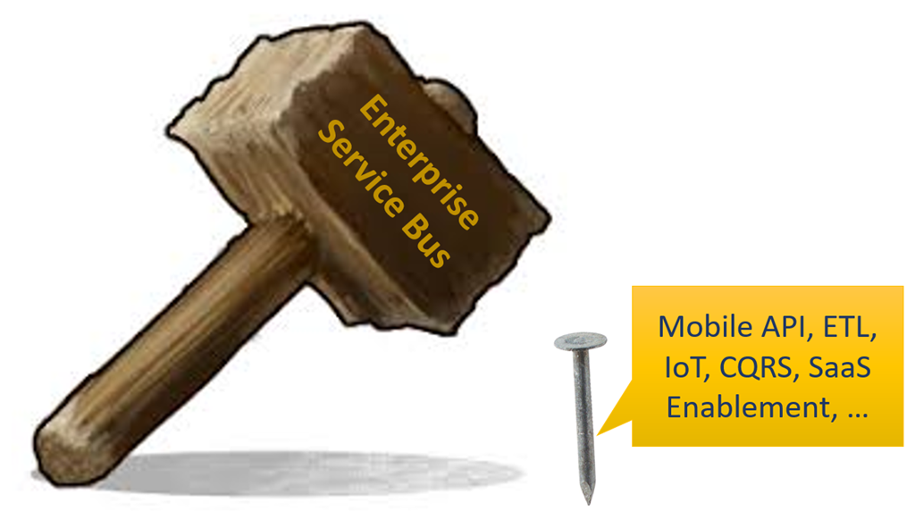


Changing Views on Integration from Service Bus to API Gateway, Serverless & iPaaS
AUSOUG Webinar – 6th May 2020
Lucas Jellema, CTO & Architect AMIS | Conclusion

Slide 2
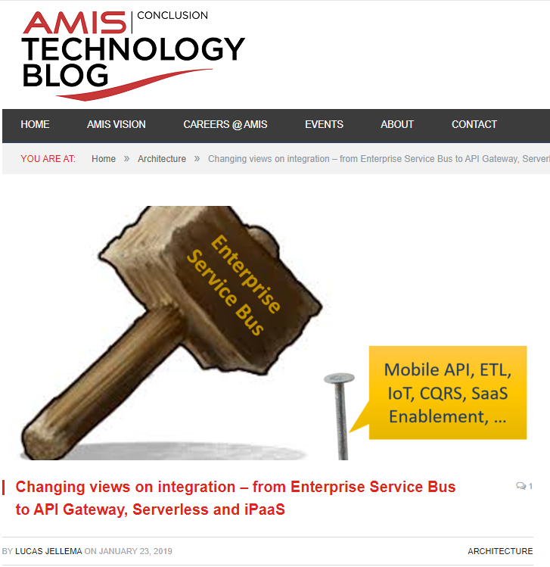
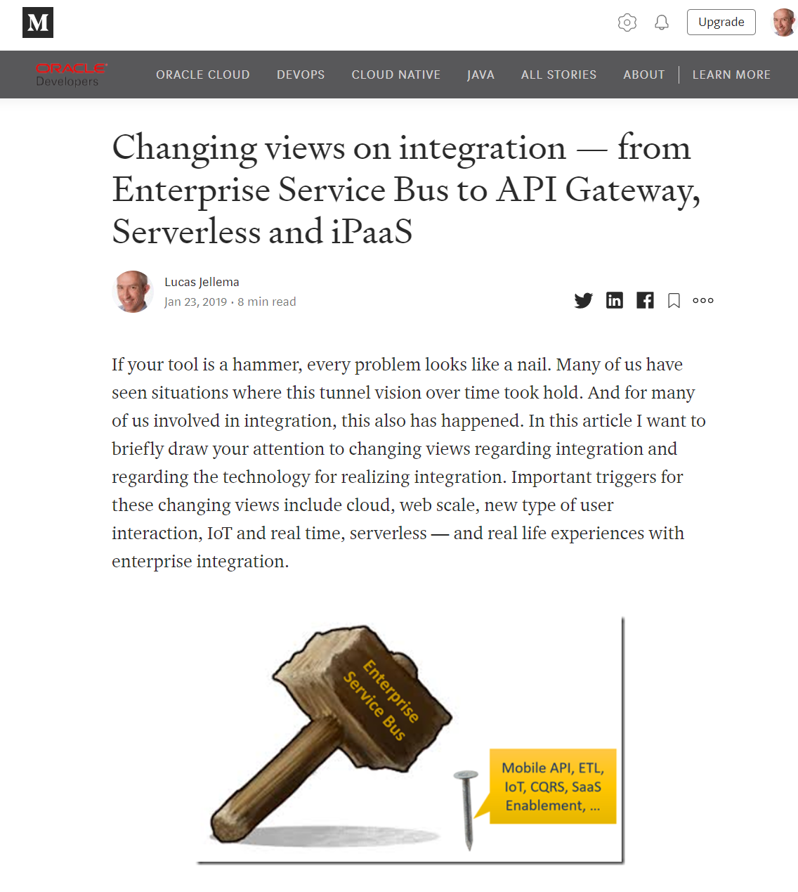
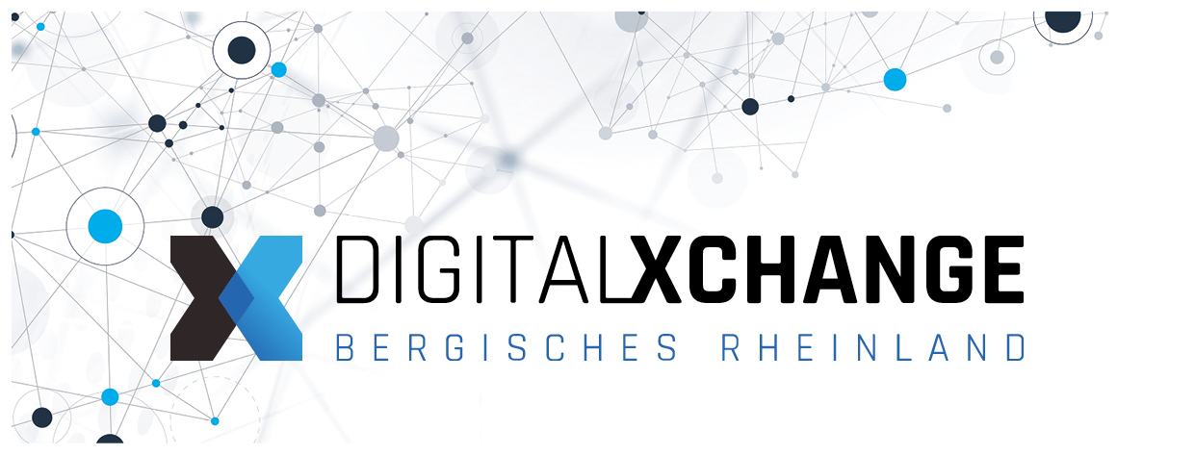


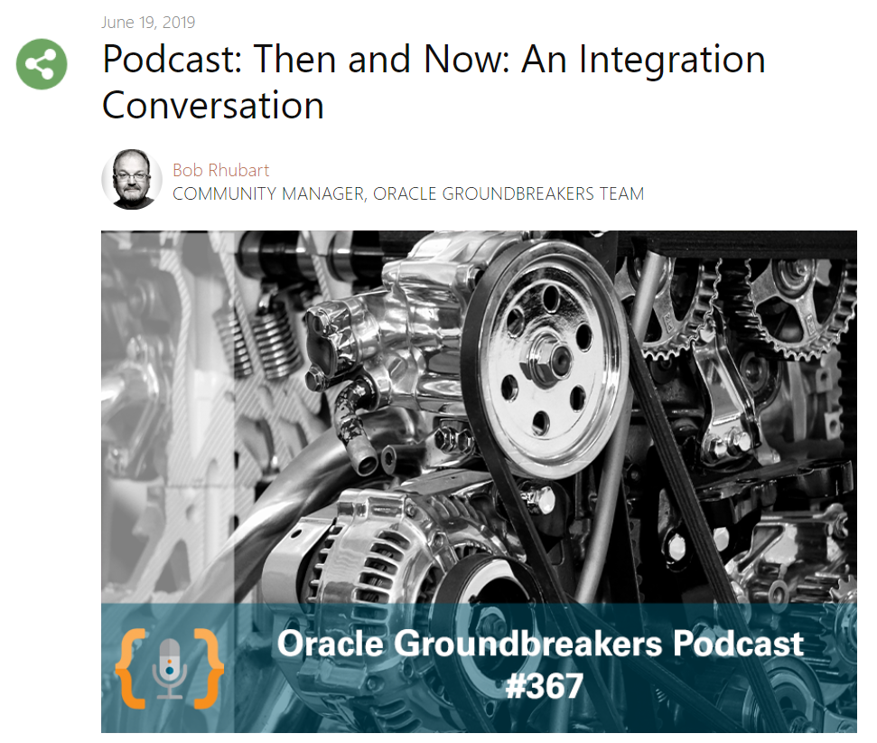


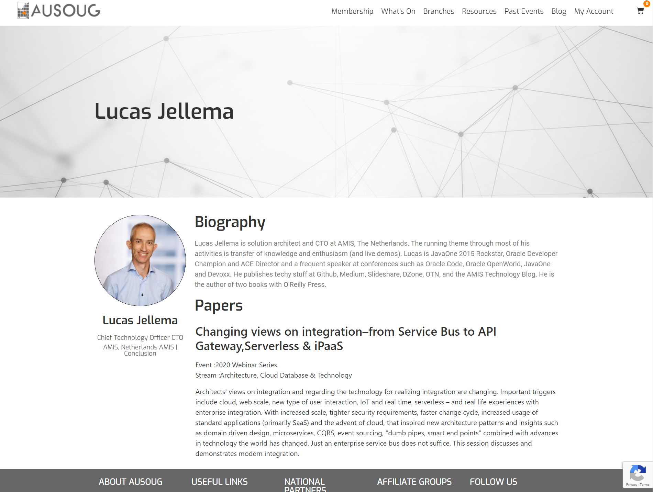
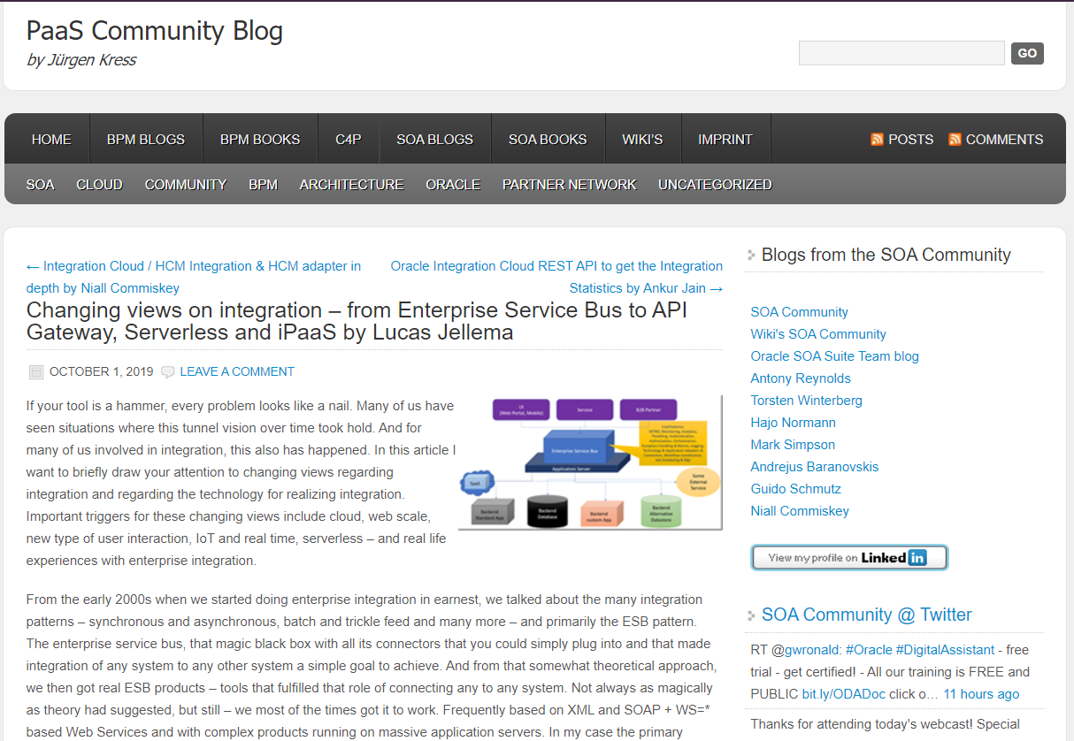

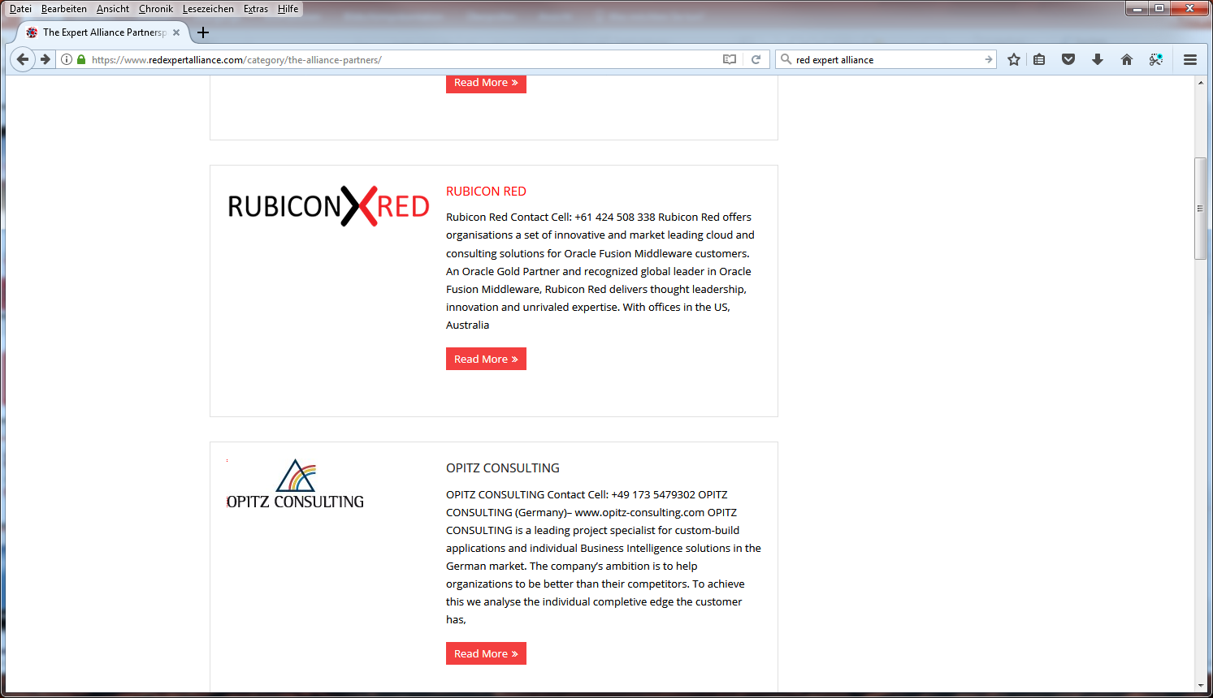






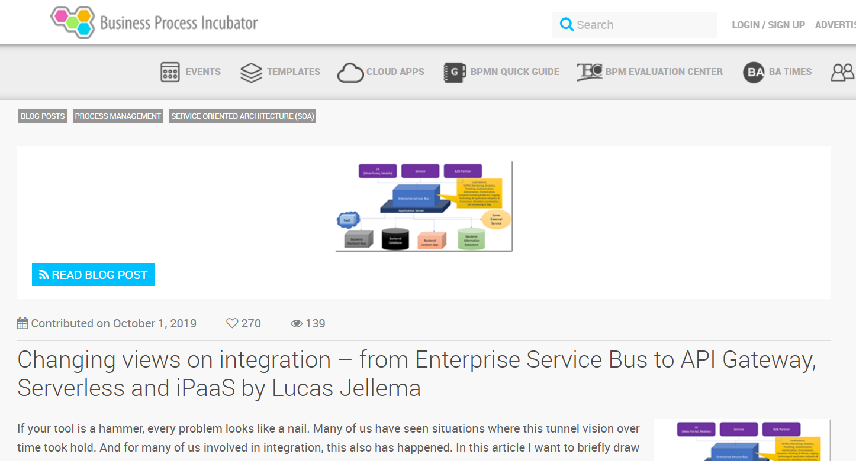






Slide 4
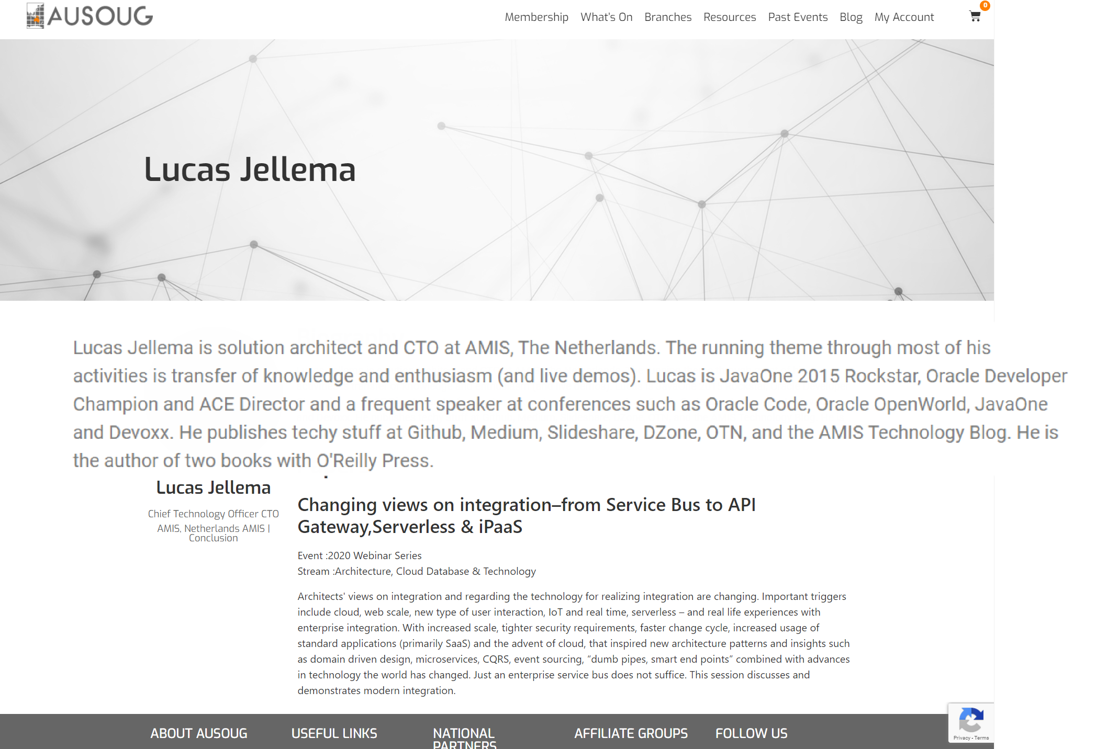
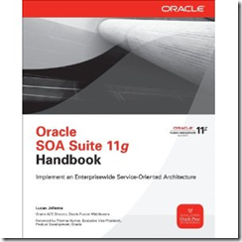
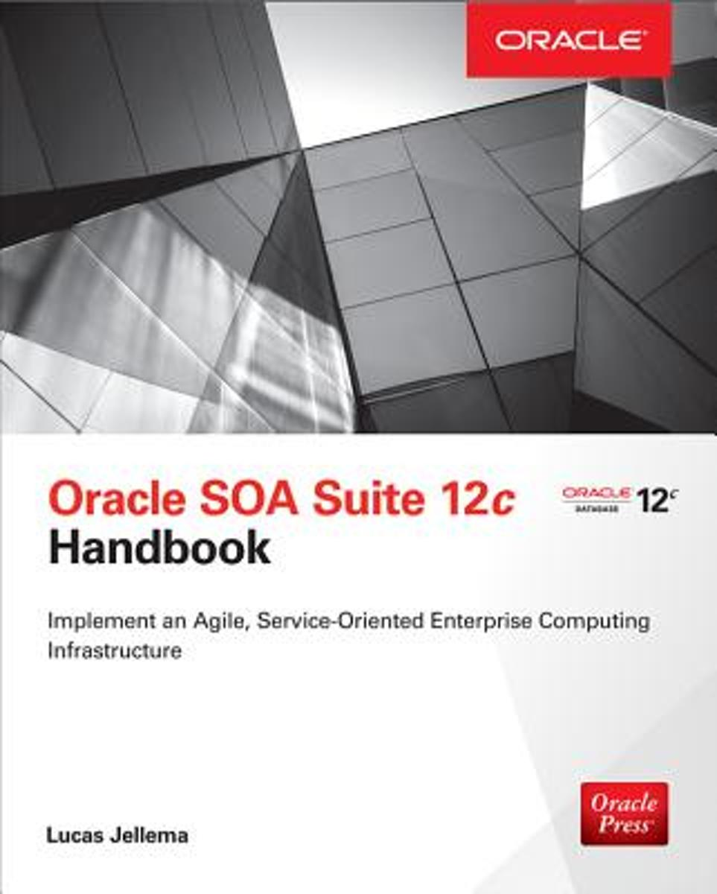

Slide 5
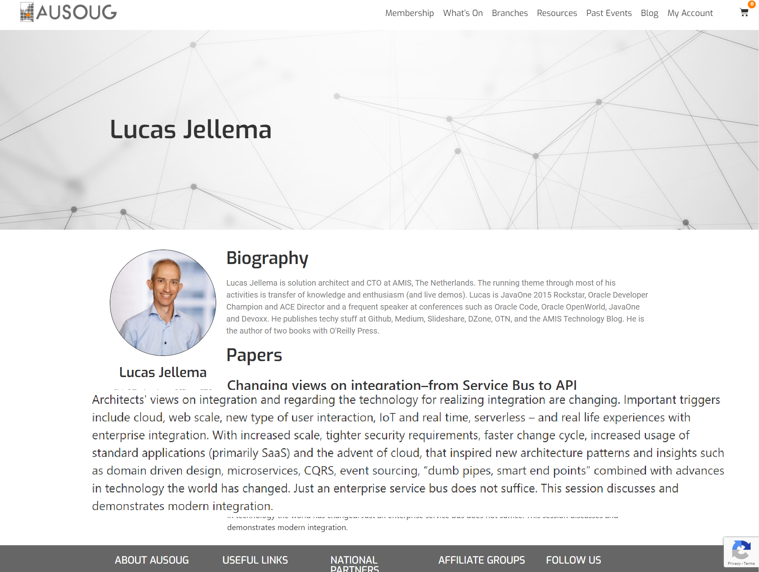

Slide 6
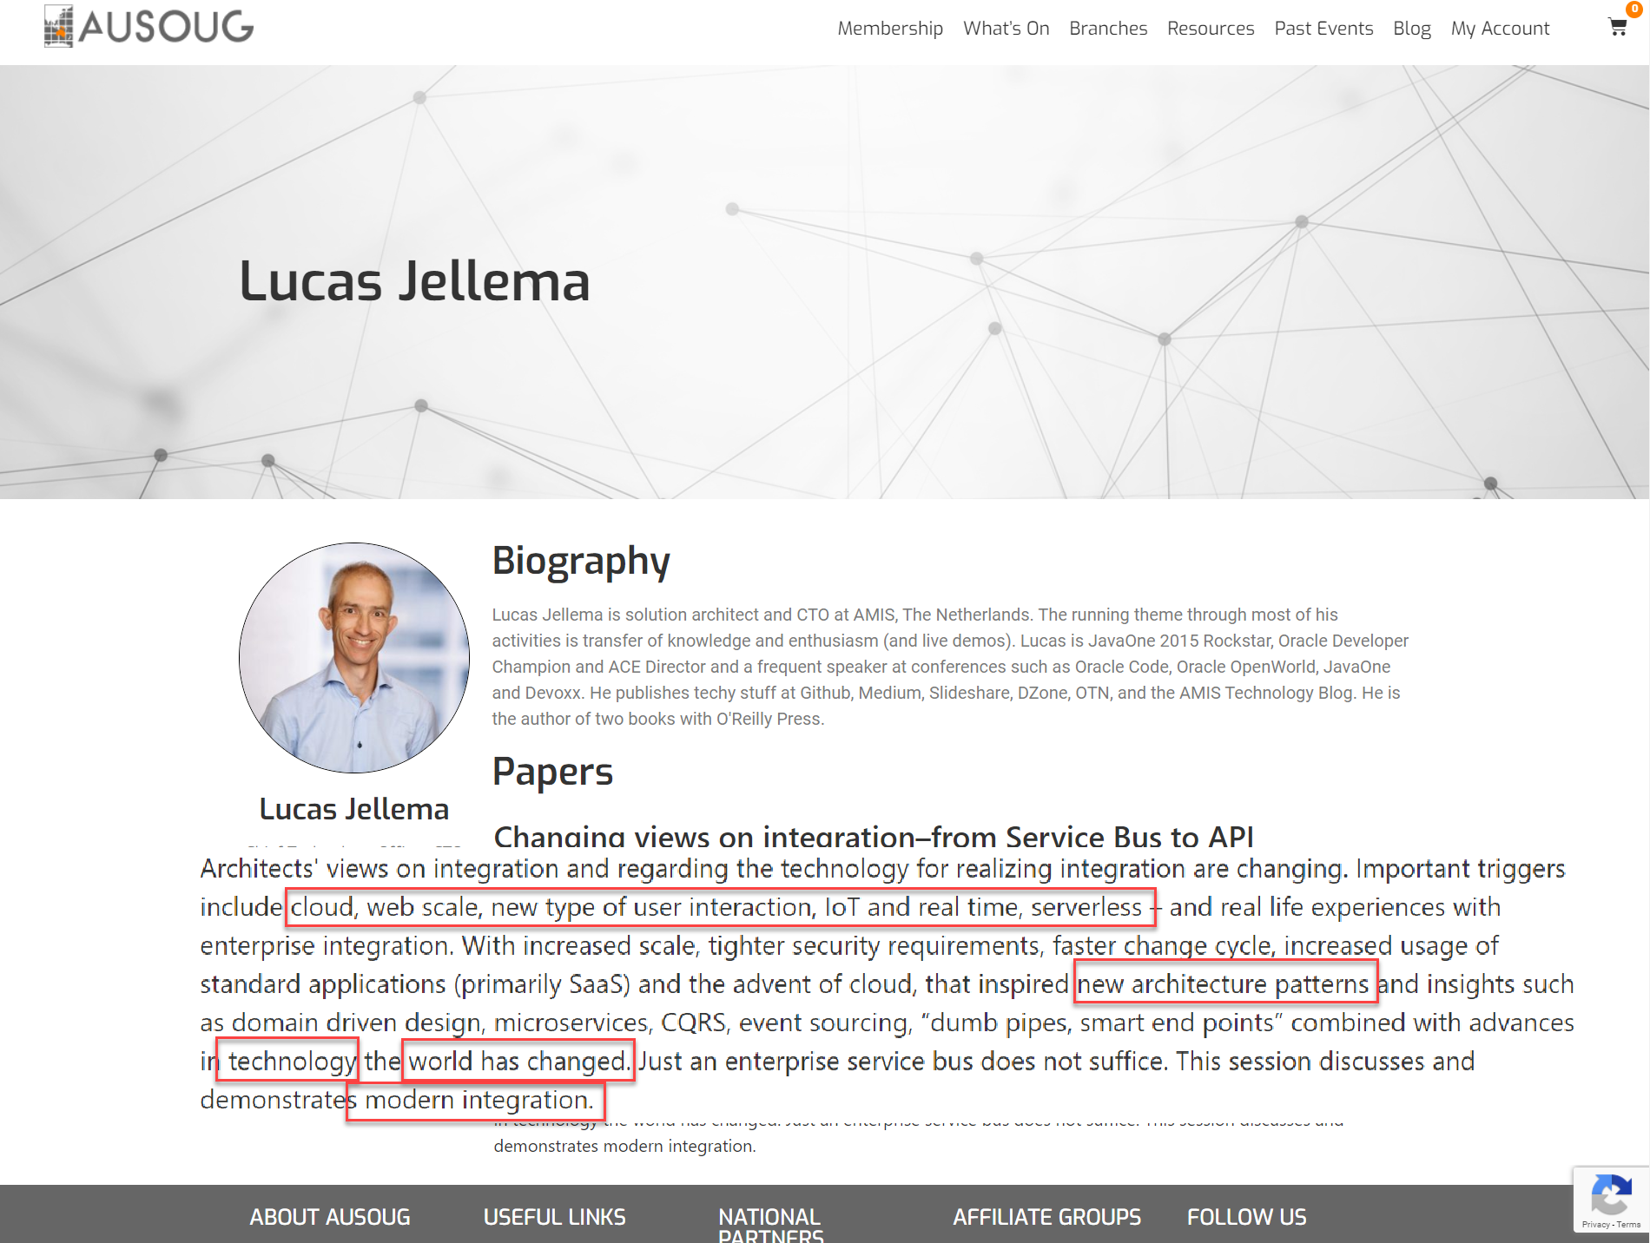

Slide 7
Agenda
What is integration?
Integration challenges
“Traditional” integration approach
Recents insights and developments
Integration Patterns
Out of the Box
Conclusion
Notes:
1) Introduction: What is integration? (Panel)
2) Common challenges (anecdotes, horror stories) (Panel)
3) Traditional approaches (Single person)
4) Typical challenges of the traditional approaches (Panel)
5) Recent insights/developments (Panel)
6) 3 Main integration styles (Single person per integration style)
6.1) Vertical
6.2) Horizontal
6.3) Event-Based
7) Asynchronous is almost always better (single person)
8) Think out of the box (Single person)
9) Conclusion: what is the same today with integration, what has not changed and also what changed? (Panel)

Slide 8
What is integration?

Slide 9
What is integration?
Simple definition: enabling systems to talk to each other
X
X
System A
System B
Notes:
Arturo’s notes:
-For a long time we have thought of system integration as the process of aggregating several subsytems to look and behave as one big system, usually known to the business as “the system”. Under this paradigm, centralizing elements such as data, business rules, transformation rules, UIs, etc. becomes key and thus the relevance of the term “middleware” when it comes to traditional EAI. Nowadays though, with evolved technology, improved delivery channels and increased awareness, we’re not so concerned about centralizing anymore, and even in some cases we want to start decentralizing in order to reap the benefits and flexibility of modern distributed systems, but also to reduce overhead and give breathing room to middleware platforms which are at risk of becoming unmanageable.
-So what I mean to say is that system integration has become increasingly complex as the general IT landscape and the requirements grow in complexity as well; however, recent insights and developments have enabled us to reverse this trend by going back to simpler patterns and paradigms which are better suited to cope efficiently with the growing complexity of the world around us from an integration perspective.
-That being said and regardless of the methods we choose, there are a number of goals, principles, facts, etc. which we’ve known to be true for a long time and still are after all of our experiences, for example: spaghetti integration is a no-no, well-designed common data models and standards can be very useful, discoverability and neat service contracts add huge value to our efforts, heavy vendor lock-in is a big liability, etc.

Slide 10
What is integration?
Ensure that data is where it is needed when it is needed in the form in which it is needed
System A
System B
Notes:
Arturo’s notes:
-For a long time we have thought of system integration as the process of aggregating several subsytems to look and behave as one big system, usually known to the business as “the system”. Under this paradigm, centralizing elements such as data, business rules, transformation rules, UIs, etc. becomes key and thus the relevance of the term “middleware” when it comes to traditional EAI. Nowadays though, with evolved technology, improved delivery channels and increased awareness, we’re not so concerned about centralizing anymore, and even in some cases we want to start decentralizing in order to reap the benefits and flexibility of modern distributed systems, but also to reduce overhead and give breathing room to middleware platforms which are at risk of becoming unmanageable.
-So what I mean to say is that system integration has become increasingly complex as the general IT landscape and the requirements grow in complexity as well; however, recent insights and developments have enabled us to reverse this trend by going back to simpler patterns and paradigms which are better suited to cope efficiently with the growing complexity of the world around us from an integration perspective.
-That being said and regardless of the methods we choose, there are a number of goals, principles, facts, etc. which we’ve known to be true for a long time and still are after all of our experiences, for example: spaghetti integration is a no-no, well-designed common data models and standards can be very useful, discoverability and neat service contracts add huge value to our efforts, heavy vendor lock-in is a big liability, etc.

Slide 11
Integration Sample Scenarios
EnterpriSe Backbone
Real Time
Events
Orders in Web Shop need to be distributed to and processed by Order Entry, Order Picking (and Shipping) and Invoicing
Measurements from Sensors need to be cleansed, filtered, aggregated and routed to Monitoring application
Social media team needs to have access in their content management system to all posts across all platforms mentioning the company
Our customers need to be able to track and trace their requests as they are processed throughout our organization
Changes in address details for patients need to be applied in all systems that hold patient records
The website needs to show to our customers the actual listing of products, reviews, prices and stock information
The loyalty points associated with an in-shop purchase have to be processed instantaneously to allow them to be used by the customer for their next purchase
Systems
Access
Transformed
Data
IoT
Distributed
Changes
External

Slide 12
Integration challenges

Slide 13
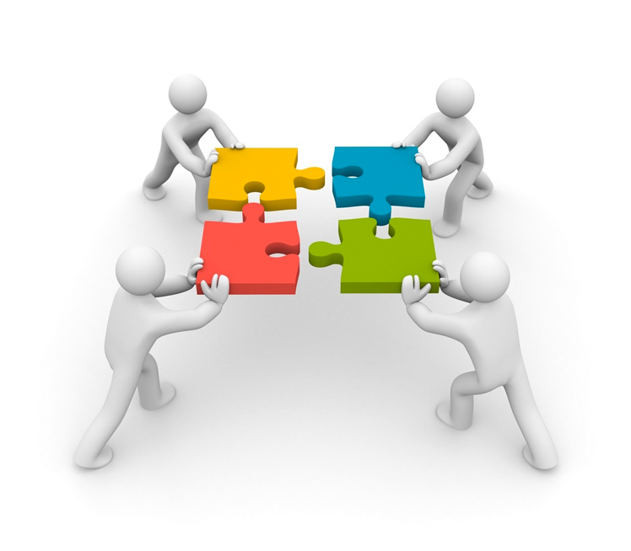
Integration Challenges
Monolithic / aging / closed systems
Disparate data models
Architectural complexity
Flexibility and productivity
Costs substantial and Business Value not so clear
Heterogeneous ecosystem
Technical debt
Bloated projects / overhead
Visibility / error handling
Production deployment
Non-functional Quality of Service
availability, performance, scalability, security
Notes:
Arturo’s notes:
-I think we know the challenges quite well and the audience should be familiar with our experiences and horror stories; an interesting point when we’re looking at a traditional approach where an organization’s expensive middleware / ESB is supposed to “magically” solve every integration challenge through tons of features and adapters, is that the rest of systems and components in the ecosystem tend to happily incur and accumulate technical debt as they would claim that these issues are for the integration layer to fix / sort out. This kind of dynamic isn’t healthy nor conducive to innovation, agility, scalability, etc. which are characteristics associated with solving contemporary IT challenges and modern application development.

Slide 14

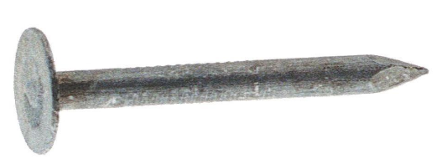
Enterprise Service Bus
Mobile API, ETL, IoT, CQRS, SaaS Enablement, …
Notes:
Our tool of choice is the ESB - and any integration challenge is a nail that we will hit with that hammer

Slide 15
“Traditional” integration approach
Notes:
Within this section we’ll also talk about challenges, as well as horror stories and anecdotes

Slide 16






ESB as basic architecture element
global
internal
specific
External Interfaces – Proxy Services
Integration Logic
(Validate Enrich Tranform Route Operate)
Enterprise Service Bus
Internal Interfaces – Business Interfaces

Slide 17
UI
(Web Portal, Mobile)
Load balance, En/De-cryption,
VETRO, Monitoring, Analytics, Throttling, Caching, Authentication, Authorization, Orchestration, Circuit Breaking, Exception Handling & Retries, Logging, Technology & Application Adapters & Connectors, Workflow coordination, Job Scheduling & Mgt
Service
B2B Partner
Enterprise Service Bus
SaaS
Application Server
Some External Service
DWH??
Backend Database
Backend Alternative Datastore
Backend Standard App
Backend custom App

Slide 18
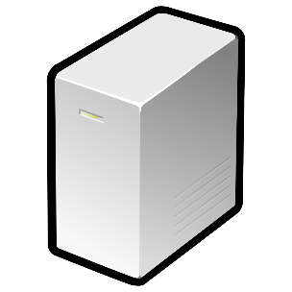




Limited and expensive Scalability
Loadbalancer
ESB 1
ESB 2
ESB 3

Slide 19

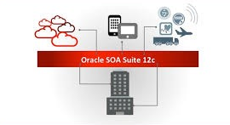







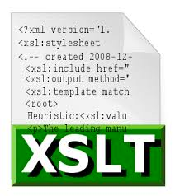

Caught in a vendor and/or technology Trap
Oracle SOA Cloud Service
Fixed Technologies Set
{
„dialect“:“JSON“
}
<XML />

Slide 20
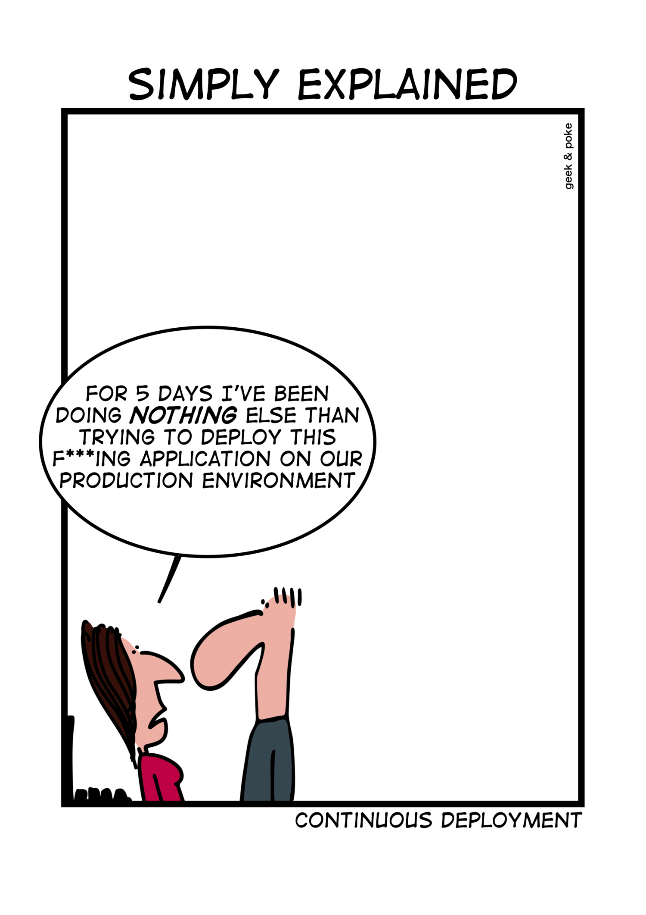
Limited agility
Hard to implement Continuous Integration / Continuous Delivery
Complex infrastructure
Missing automated testing capabilities
Single Point Of …
Monolithic deployment approach
Monolithic management (scalability, load balance etc.)
Expert knowledge needed
Implementation
Deployment
Error analysis and resolution
TCO
http://geek-and-poke.com/

Slide 21
Insights and developments
Notes:
What has changed? What have we learned?
- integration in the past decade was frequently less than wildly successful; complex, expensive, slow, unstable, un-agile
one of the key distinctions in my mind between SOA (WebServices) and API: less focus on reuse, more focus on the consumer of an API
With further increased scale – because of real time and web scale demands introduced by IoT and a further growth of the use of Apps – ,
No/less strict delineation between Enterprise (message based) Integration and ETL/Data Integration
tighter security requirements,
faster change cycle (Agile, DevOps),
24/7 Operations
increased usage of standard applications (primarily SaaS)
and the advent of cloud (necessity to support hybrid scenarios - cross on premises and cloud as well as multi vendor cloud,
that inspired new architecture patterns and insights such as domain driven design, microservices, CQRS, event sourcing, “dumb pipes, smart end points” combined with
advances in technology and industry standards – for example containers, serverless, REST, API technology – JSON (vs XML), REST (vs SOAP), containers, serverless, “embedded HTTP server”, industry standards like Kafka
Potential of machine learning
Scarcity of talent/developers
Is a canonical model/language such a good idea? What about ‘domain/context mapping’ and ‘anti corruption layer’ from domain driven design

Slide 22
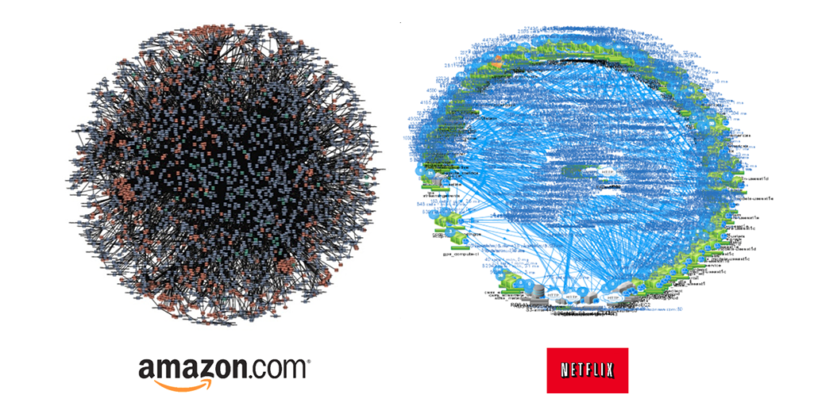
The world is getting more complex interesting!
Notes:
More complex AND faster and at larger scale (IoT, Web Scale, Global, 24/7 operations)

Slide 23

New insights, new context, eroded dogmas
Increased scale – because of real -time and web scale demands (introduced by IoT and a further growth of the use of Apps )
Need for speed - real time insights from fast data streams
No/less strict delineation between Enterprise (message based) Integration and ETL/Data Integration
Tighter security requirements (GDPR to name one)
Faster change cycles (Agile, DevOps)
24/7 Operations (no down time or batch | release | maintenance windows)
Scarcity of talent/developers
Is a canonical model/language such a good idea? What about ‘domain/context mapping’ and ‘anti corruption layer’ from domain driven design

Slide 24
New insights, new context, eroded dogmas (2)
We have learned to ask: How fresh should data be? How crucial is ACID and instant consistency?
Realization that reusability (service & data) is not the holy grail (one of the fallacies of SOA: SPoF)
Increased usage of (several) standard applications (primarily SaaS)
The advent of cloud (necessity to support hybrid scenarios - across on-premises and cloud as well as across multi-vendor cloud)
New architecture patterns such as domain driven design, microservices, CQRS, event sourcing, “dumb pipes, smart end points”
Advances in technology, containers, serverless, REST, API technology – JSON (vs XML), REST (vs SOAP), containers, serverless, “embedded HTTP server”, industry standards like Apache Kafka
TCO of Middleware Platforms (run/operate & develop/evolve)
Strategic roadmap of middleware vendors: Cloud, Cloud Native & Microservices

Slide 25
Integration patterns

Slide 26
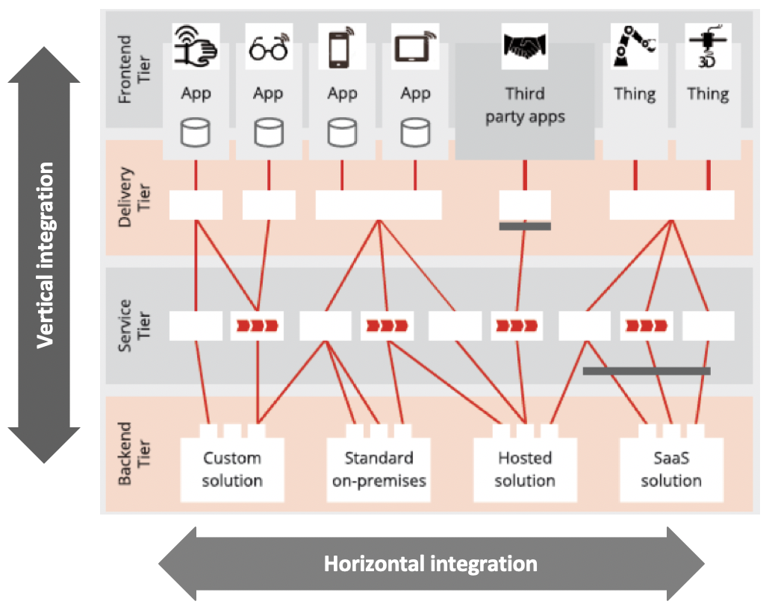
Two dimensions of integration

Slide 27


Vertical integration
Client Application
Synchronous (End User) ”integration”
API Gateway as runtime component for
API policy enforcement
Request routing
(Near) Real-time, synchronous interactions
APIs born from business requirements
Who is using the API?
How is the API being used?
Not so much focus on reusable, generic interfaces
Use of lightweight, standard protocols
API Gateway
Customer API
Vertical Integration
CRM Database

Slide 28
UI
(Internal) Microservice
B2B Partner
API Gateway
Load balance, Routing, Monitoring, Analytics, Throttling, Authentication, Authorization, Circuit breaking, controlled release ( A/B Testing, Canary Release )…
Single Purpose API
Multi Purpose API
Some External Service
Multi Purpose API
Backend Database
Backend Alternative Datastore
Backend Standard App
Backend custom App

Slide 29
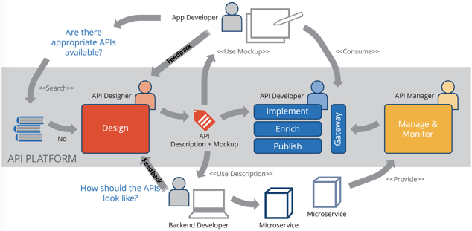
API first design approach

Slide 30





Evolution of ‘vertical integration flow’ implementation
API Gateway
API Gateway
API Gateway
Enterprise Service Bus
Vertical Integration
Application Server
Implemen
tation
Implemen
tation
Implemen
tation
Implemen
tation
Implemen
tation
Kubernetes
Serverless
Functions
λ
App DB
App DB
App DB
App DB
Notes:
Clearly, this evolution leads to increased scalability and reduced overhead in administration of the runtime platform. Compared to the frequently declarative style of development on the ESB platform, there may some initial loss in development productivity. That is easily off set by the much better tool support for automated CI and CD and also compensated by the much wider availability of developers able and willing to with modern, generic technologies compared with vendor specific proprietary platform products.

Slide 31




Real Life Case of Vertical Integration: Loyalty Card Scan
Stores (PoS)
100sK Card Scans per day;
card scan is transaction; response time < 800 ms
OSB
OSB
OSB
Camp aigner
OSB
JMS
RETEK
MFT
Web Logic
ODI
Golden Gate
PLQ
LINK
Data Warehouse
Retail Chain - on premises infrastructure
Primary Region UK
(secondary) Disaster Failover Region Germany
OUR DB
Siebel
Siebel DB
Siebel DB
Loyalty X

Slide 32
Real Life Case of Vertical Integration: Loyalty Card Scan
Stores (PoS)
100sK Card Scans per day;
card scan is transaction; response time < 800 ms
API Gateway
Camp aigner
OSB
JMS
RETEK
MFT
Web Logic
Card Scan
ODI
Golden Gate
PLQ
LINK
Data Warehouse
Retail Chain - on premises infrastructure
Primary Region UK
(secondary) Disaster Failover Region Germany
OUR DB
Siebel
Siebel DB
Siebel DB
Loyalty X

Slide 33
Real Life Case of Vertical Integration: Loyalty Card Scan
Stores (PoS)
100sK Card Scans per day;
card scan is transaction; response time < 800 ms
API Gateway
Camp aigner
OSB
JMS
RETEK
MFT
Web Logic
Card Scan
ODI
Golden Gate
PLQ
Card Scan
Kubernetes
Card Scan
Card Scan
Card Scan
LINK
Data Warehouse
Retail Chain - on premises infrastructure
Primary Region UK
(secondary) Disaster Failover Region Germany
OUR DB
Siebel
Siebel DB
Siebel DB
Loyalty X

Slide 34
Horizontal integration
Classic System2System integration
Eventual
Background, Asynchronous interaction patterns
Batch processing, increasingly Straight Through Processing (STP)
High volume, complex scheduling and orchestration
Technical interfaces, heavy-duty, proprietary protocols
Evolving Insights: relaxed freshness and consistency demands, data replication
Changing context: cloud & hybrid, “dumb pipes, smart endpoints”, Standard Apps & SaaS evolution, agile (change, deploy, scale, pay)
System A
System B
Notes:
Many interactions are not synchronous, do not involve consumers with an urgent request and may be triggered by systems events or simply by time. These interactions typically take place in the background in an asynchronous fashion. These interactions have to be observed as they are executed in the background. Do they get completed successfully? Can they survive the temporary unavailability of the target system? Will processing time stay acceptable when the volume increases?
Critical in the implementation of these interactions is the use of a message queue or an event bus – a decoupling mechanism that provides a bridge across domains, (versions of) systems, locations (cloud & on premises), technologies and time. This event bus also allows load balancing across multiple processors, throttling and circuit breaking in case of limited downstream capacity and is a crucial element in governance.

Slide 35
Horizontal integration
Technology & Application Adapters & Connectors, Workflow coordination, Event Bus, Exception Handling, Job Scheduling & Mgt, Transformation, Routing, Monitoring, Streaming Analysis, Authentication,
API Gateway
Execute workflow (across multiple systems & people?)
IoT
µ
Event driven, asynchronous notification
Backend Standard App
Backend Database
Fulfill synchronous request or command
(periodic) data synchronization, replication
Backend custom App
SaaS
Notes:
Many interactions are not synchronous, do not involve consumers with an urgent request and may be triggered by systems events or simply by time. These interactions typically take place in the background in an asynchronous fashion. These interactions have to be observed as they are executed in the background. Do they get completed successfully? Can they survive the temporary unavailability of the target system? Will processing time stay acceptable when the volume increases?
Critical in the implementation of these interactions is the use of a message queue or an event bus – a decoupling mechanism that provides a bridge across domains, (versions of) systems, locations (cloud & on premises), technologies and time. This event bus also allows load balancing across multiple processors, throttling and circuit breaking in case of limited downstream capacity and is a crucial element in governance.

Slide 36
Challenges with Horizontal Integration
Handle requirements for speed, consistency, volume & [global] distribution
Detect Change
Extract Data
Publish Change
Transport
deal with limited connectivity, temporary unavailability
Convert/Transform
Apply
Monitor
Handle exceptions
Enforce constraints & authorization
Spot and Handle Errors
Governance & Evolution
Detect changes
Extract Data
Enforce Constraints & Authorization
Source System
Transport Data
Convert Data
Apply Data
Destination
Decoupling Queue

Slide 37
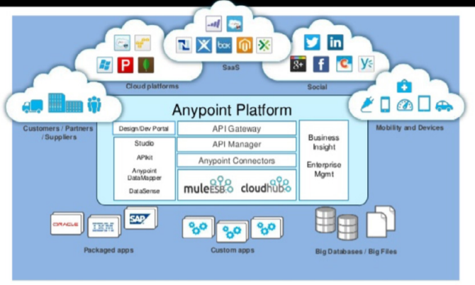
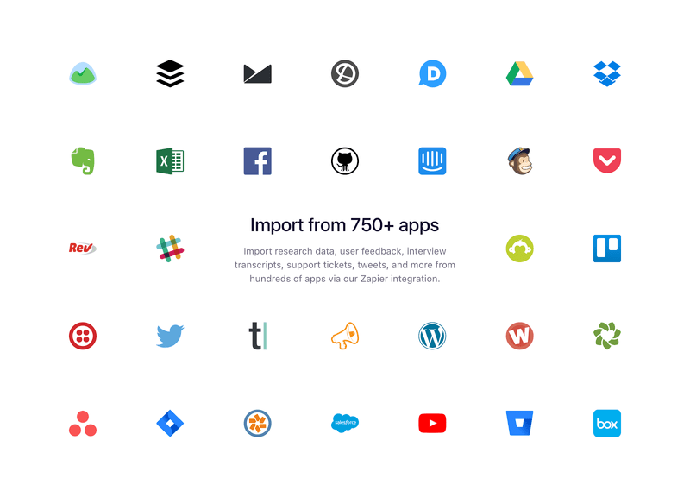
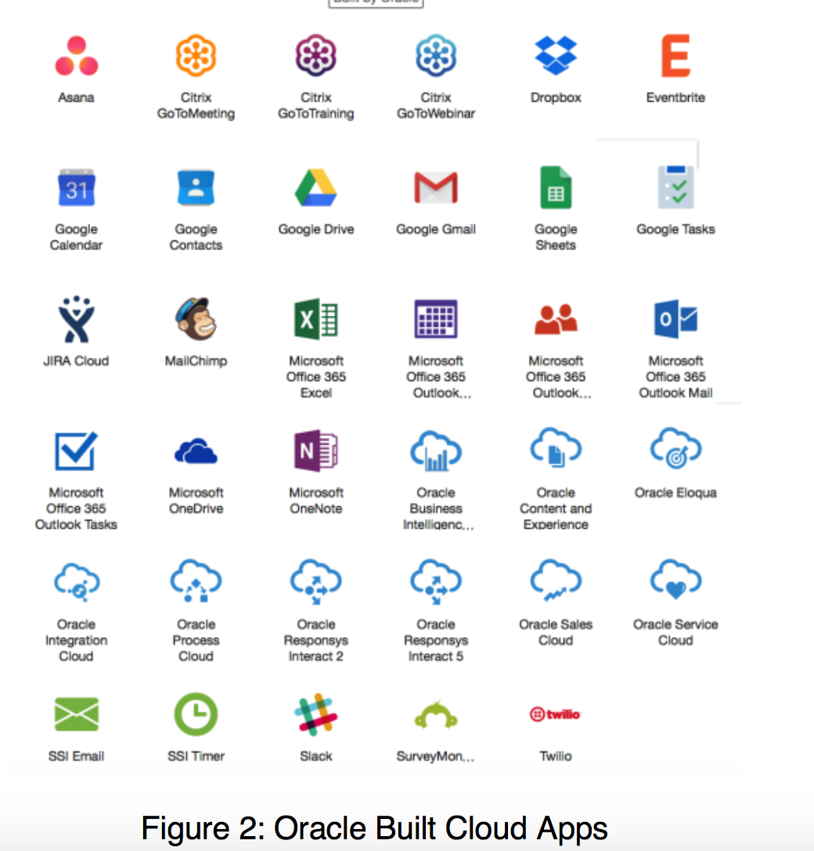
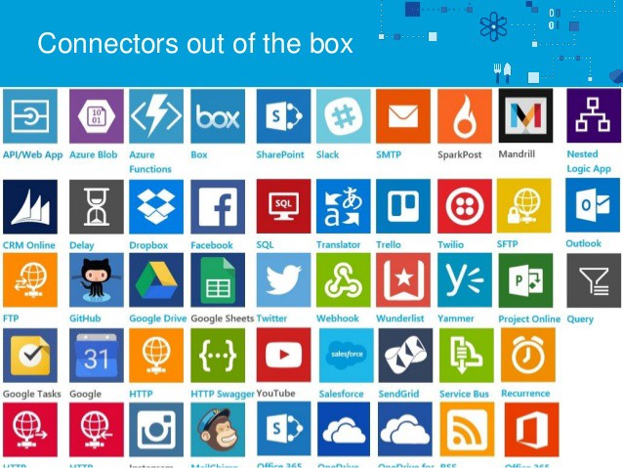

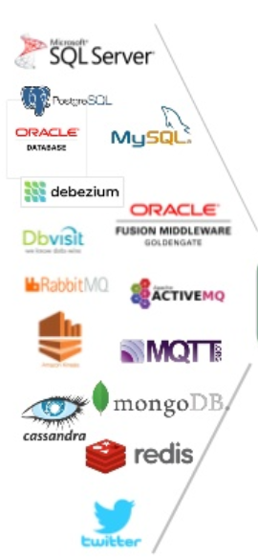
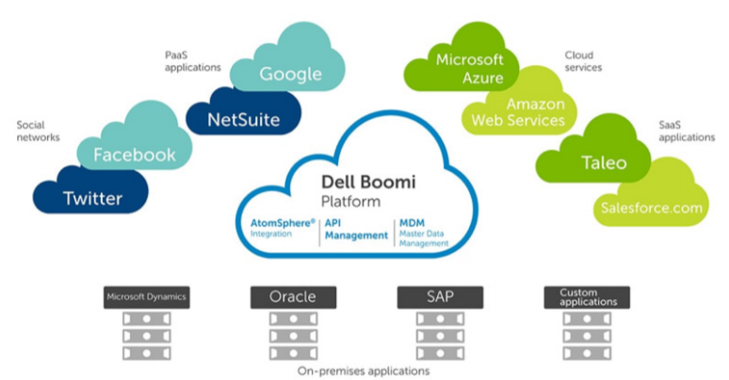
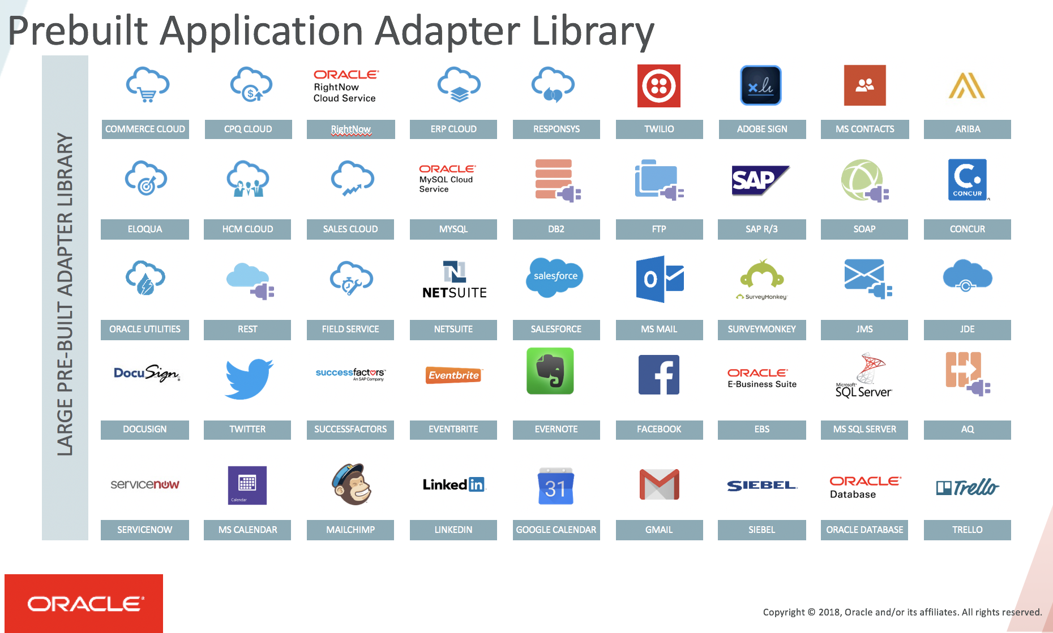

(Cloud) Adapters & iPaaS platforms To connect, detect & extract (from source) and connect & apply (to sink)
Debezium
Notes:
AnyPoint
Zapier
SSI
OIC
Dell Boomi

Slide 38

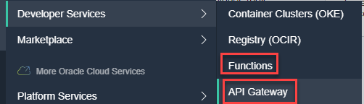
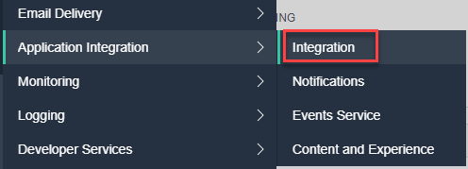
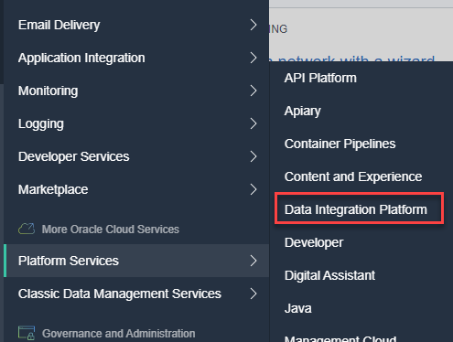
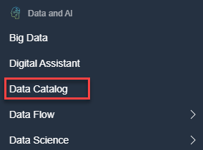
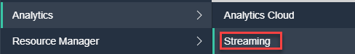
Integration and Integration?
Evolved from Oracle Service Bus and SOA Suite
Evolved from Oracle Data Integrator (ODI) and GoldenGate

Slide 39
Data Pipeline is special type of Horizontal Integration
Hot Flow of Real Time Streaming Data
Data Services
Internal and Public APIs
Machine Learning
Deploy & Leverage
Data Warehouse
“Data Mart” single purpose data set
Machine Learning Model
Ingestion
Data Wrangling
“Data Mart” single purpose data set
Raw/ Operational Data Sources
“Data Mart” single purpose data set
Data Lake
“Data Mart” single purpose data set
Business Intelligence
Dashboard, Notification & Alert Report, Visualization, Gamification, Data Explorer
3rd party data sources
Business insight: what, when, who and why
algorithms
Master Data Management, Meta-Data Management, Data Governance
Data Access, Authorization, Privacy
Notes:
Iteratief – keer terug naar voorgaande stap om meer data, andere wrangling

Slide 40
The Third Dimension
Both Horizontal and Vertical Integration are pre-determined
end-to-end chains from specified source(s) to a designated target
triggered by synchronous requests and time events (batch)

Slide 41
Events aka Messages
Multi: multiple publishers to same topic, multiple subscribers on same topic (or none);
Decoupled: publishers to not know about consumers and vice versa; consumers can receive messages from when they were off line
Consumers
Producers
Event Hub
Independent intermediary
Robust, Scalable, Fast, History Retention
Open

Slide 42
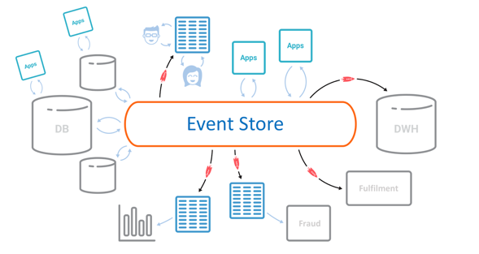
Event-Driven Integration
Instead of the API definition and runtime endpoint, Event Consumers need the Message definition, the Topic name and the endpoint of the Event Store (aka Event Hub)
Optional: forwarding endpoint of consumer when Pub/Sub with Push
Notes:
Arturo’s notes:
-This slide I will only show quickly because I really “hate” it, as it’s a really poor way and unimaginative of representing an EDA (basically replacing the ESB by an Event store or event bus)
-Also, one of the main goals of modern architectures / EDAs is to decentralize, decouple, reduce friction & single PoF

Slide 43

Out of the box
Ahead of Time Integration & CQRS
Event Sourcing
Collective Data Set

Slide 44








Utility Company looking for Performance, Scalability and Availability in their core data sets
Marketing Campaigns
Invoicing
CRM
Billing
Meter Readings
batch

Slide 45
Utility Company looking for Performance, Scalability and Availability in their core data sets
Customer Portal
Marketing Campaigns
Invoicing
CRM
Enterprise Service Bus
Billing
Meter Readings
batch

Slide 46

Utility Company looking for Performance, Scalability and Availability in their core data sets
Customer Portal
Marketing Campaigns
Invoicing
CRM
Enterprise Service Bus
Billing
Meter Readings
Load on Core Systems & effect on Performance
Availability Core Systems,
Sizing & Cost & Complexity ESB
batch

Slide 47
Utility Company looking for Performance, Scalability and Availability in their core data sets
Marketing Campaigns
Customer Portal
CRM
Invoicing
CRM Cache DB
Meter Readings
Billing
Meter Readings Cache DB

Slide 48



Utility Company looking for Performance, Scalability and Availability in their core data sets
Marketing Campaigns
Customer Portal
CRM
Invoicing
CRM Cache DB
Meter Readings
Billing
Meter Readings Cache DB

Slide 49
Practical Challenges
Marketing Campaigns
Customer Portal
Publish all [fine grained] change events from sources
Event schema evolution
Lag in Cache Databases
“eventual consistency”
Differences between sources and cache databases
Initial creation of Cache Databases
General Scale and Incidental event storm
Business and Mission Critical availability
Data Authorization
Logic enforced in source (applications)
GDPR
CRM
Invoicing
CRM Cache DB
Meter Readings
Billing
Meter Readings Cache DB

Slide 50
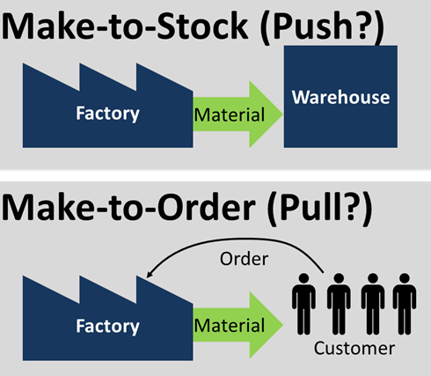
JIT vs AOT

Slide 51
JIT vs AOT Data Integration
JIT
Process [synchronous] request for data ‘just in in time’
Performance overhead suffered at (every) request time
Only data that is requested
Fresh as can be
All authorization rules applied
Single Source of Truth
Transformation & Aggregation at request time
Hard (runtime) dependencies from consumer on producer
AOT
Pre-process / pre-share data ‘ahead of time’
Potentially includes data that will never be requested
Data can be outdated

Slide 52

CQRS => Specialized Query Stores
Cater for different (read) Data Usage Scenarios
Different in:
Why
What – grain, aggregation, breadth, type of and variation in queries
How – format, language, accuracy and freshness, consistency
When – frequency, time of day | week | month, 24/7
Where – latency, band width, off line
Who – scale, different roles & user groups

Slide 53

CQRS => Optimized Data Set for Special Use Case
Shape & Format
Right Grained (aggregation, consolidation)
Filtered
Enriched (from multiple sources)
Location
Time (refreshed at the right time)
Search Options
BASE (eventually – when? – consistent)
Authorization
GDPR
Frontend
BFF API
C
Q

Slide 54
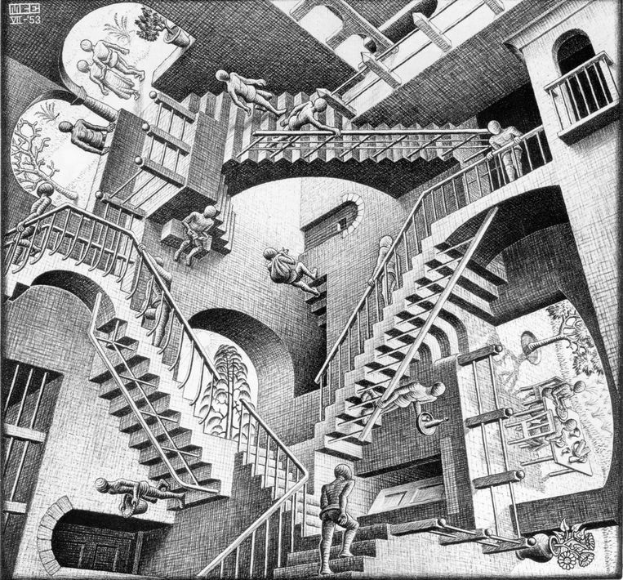
CQRS: A small step for mankind but a giant leap for [IT] architects

Slide 55


Typical CQRS Architecture
Source systems
Change Reporters
Distributed Change Event Hub
Change Projectors
Destination systems
Transform & Apply
Poll
Event Platform
Detect & Retrieve Change
(re)Calculate & Record
Consume
Convert, Translate, Store
Event Schema Governance
Monitoring & Error Handling
Notes:
Destination system: can be cache, or even only the programmatic representation – without any data duplication
Dumb pipes, smart end points

Slide 56
Event Sourcing

Slide 57
Utility Company: Rebuild Cache Database
CRM
CRM Cache DB
Meter Readings
Meter Readings Cache DB

Slide 58
Utility Company: Rebuild Cache Database From Event Store
CRM Cache DB
Meter Readings Cache DB

Slide 59
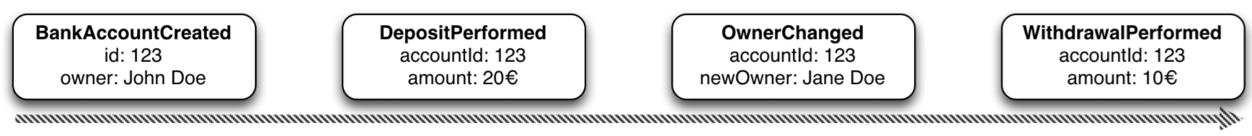
Event Sourcing Driving CQRS
amount: 10
Owner: Jane Doe
Events
Current State
Event Store
accountId: 123
Notes:
Events are immutable facts
Current state (active record) is derived from sum of events
Read optimized aggregates are created for specific use case – based on events and rebuildable at any time

Slide 60
Event Sourcing Driving CQRS
Events
Current State
Event Store
Other State Aggregate
Notes:
Events are immutable facts
Current state (active record) is derived from sum of events
Read optimized aggregates are created for specific use case – based on events and rebuildable at any time

Slide 61
Event Sourcing
Event Store is immutable – append-only log of domain state transitions
It is the truth about data – everything else is derived
Replay events
to (re)construct a representation of the current state (aggregate)
up to a specific time to recreate moments in time
in Test environment to investigate an issue
on a remote location to create mirror & share state across boundaries
produce a fine grained audit trail
Challenges
Time required to reconstruct state
Grain of aggregates / definition of domain events

Slide 62
Collective Data Set

Slide 63
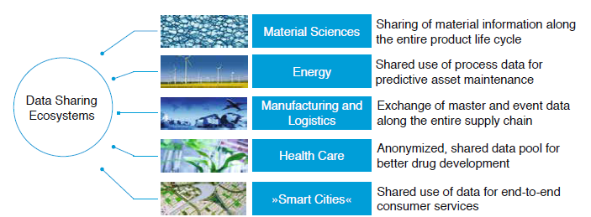
Data Sharing Ecosystems
Multiple independent organizations
Mutually benefit from having access to the same data at the same time
Share data & Have access to data with minimum of overhead and with equality among the ecosystem partners
Partners are on different network domains, physical locations, technology stacks, …
New Partners can join
Partners can leave
Consensus on what constitutes correct data

Slide 64
Collective Dataset
Company A
Company B
Company F
Company C
Collective Dataset
Company E
Company D
Notes:
Central Database plus ESB plus send updates and request data?

Slide 65
Collective Dataset
Company A
Company B
Company F
Company C
Central Database
Enterprise Service Bus
Canonical SOAP WS/ REST API for Sending Inserts/Updates/Deletes and for Requesting current data
Company E
Company D
Just In Time Integration
Notes:
Central Database plus ESB plus send updates and request data?

Slide 66
Collective Dataset = Collective Data Change Events
Company A
Company B
Company F
Company C
Central Event Platform
Interfaces for Publishing and Consuming Events
Note: events can be consumed asynchronously
Company E
Company D
Ahead of Time Integration
Notes:
Central Database plus ESB plus send updates and request data?

Slide 67
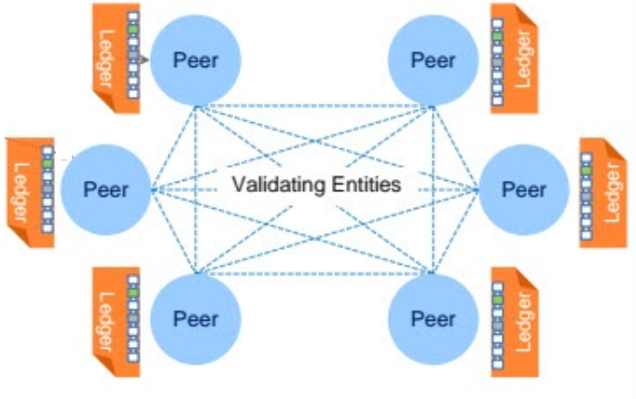

Collective Dataset => Collective Data Store
Company A
Company B
Company F
Company C
Company E
Company D
Ahead of Time Integration
Notes:
Central Database plus ESB plus send updates and request data?

Slide 68
Conclusion
Notes:
It is important to recognize that on the one hand there are many data flows in our enterprise IT landscapes that are really very similar – in essence bringing data from A to B. A lot can be gained by approaching all these flows as part of the same spectrum. On the other hand, the various shades of data flow on the integration spectrum require different approaches as well. Common data models, domain driven design and a desire for decoupling, statelessness and dynamic scalability are similar but the implementation technologies will be different. No longer should we use the ESB platform the hammer that can take on any data integration challenge as a nail. As a first step, let’s liberate synchronous interactions supporting on line clients such as Web Portals and Mobile Apps from the ESB. Let’s embrace the API Gateway plus scalable API implementation – perhaps first through containers and eventually using a serverless implementation. And let’s adopt a message queue or event bus that is scalable, accessible cross technologies and distributed – reliable and spanning across clouds and on premises.

Slide 69
Key Takeaways
Integration is as relevant as ever – probably more so
API, microservice, Data Pipeline, Streaming Data (fast & furious), Hybrid Cloud (& on prem), IoT (physical and virtual), B2B, Big Data, SaaS
The one-size-fits-all approach based on Enterprise Service Bus is replaced
Three main integration styles (Vertical, Horizontal, Event-Driven)
With fitting Patterns and Tools (Dumb Pipes/Smart Endpoints, microservices, API Gateway, Serverless, Message Queue, Adapters & Connectors, … )
Leveraging cloud technology
Out of the Box
Ahead of Time Integration (CQRS), Collective Data Set, Event Sourcing
Asynchronous is the preferred communication style
Decoupling is crucial for flexibility, availability (not brittle), scalability, distributability (“social distancing” for systems and services)

Slide 70


Thank you for your attention I hope this was useful
lucas.jellema@amis.nl | technology.amis.nl | @lucasjellema | lucas-jellema

